Slide 1



Slide 2
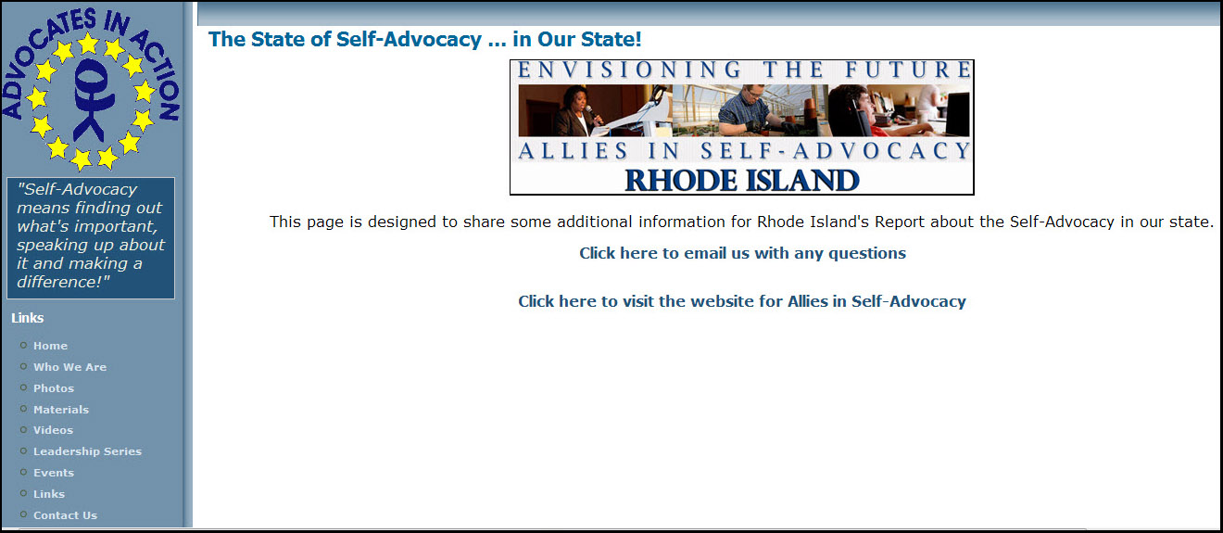
10 Minutes??
Visit us online for
MORE information and ideas:
www.advocatesinaction.org/SAinRI.php
Notes:
Before we begin, please note that this is a VERY CONDENSED version of what we wanted to say and share.
We know that there is a lot to cover here at the summit, so we created a space on our website to share more of the details about the “State of Self-Advocacy” in our state.
We have lots of other great resources available for FREE on our website, too, so CHECK IT OUT!

Slide 3
Self-Advocacy in Rhode Island?
Advocates in Action:
“AinA“ is Rhode Island’s
Statewide
Self-Advocacy
Organization
Notes:
Advocates in Action is Rhode Island’s Statewide Self-Advocacy organization.
AinA represents 10 Local Self-Advocacy Groups.
Each group appoints 2 representatives to the AinA board of directors
Board terms of office are 4 years and 5 years long and representatives may serve 2 terms in a row.
The AinA board meets 10 times a year. Hey, it’s Rhode Island … Rhode Islanders just don’t MEET in the summer! But we work extra hard the rest of the year to make up for it!

Slide 4
AinA is Almost 20 Years Old!
Notes:
We are almost 20 YEARS OLD!
1992- We worked with 8 different groups from around RI and formed the “RI Coalition of Self-Advocates”
1996 –
The groups had been meeting several times a year and sending 2 individuals each to represent them.
In 1996 we decided to “make it official”.
People thought the name “RI Coalition of Self-Advocates” was too long.
The 2 representatives from each of the 8 groups voted and “Advocates in Action”, became officially incorporated
2000 – One of our proudest accomplishments is that we were the host for the 5th National Self-Advocacy Conference. More than 1,000 people came to RIde the Wave!
2010 - 514 SA Conference Attendees
(we’re Rhode Island … that’s a lot!)

Slide 5
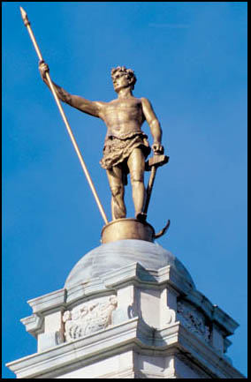

Our State Believes in
Independence and Hope
These are part of the Self-Advocacy Movement, too!
Together, we can make a difference.
Notes:
In Rhode Island we have the Independent Man on our State Capitol and our state Flag and motto is “hope”.
We think that is also true for the Self-Advocacy movement in our state.
We are an independent movement, but we connect and work together with many other organizations.
We are hopeful and we never give up.
At Advocates in Action, one motto that we often share is: Together, we can make a difference!

Slide 6

Resources?
100% of our Operating Budget
PAL is our Fiscal Agent and Long-Time Partner
Organizations, Business & Friends
Other “Income”
Notes:
Here are the resources that help us get our work done.
BHDDH
We get all of our operating funds from the RI Department of Behavioral Health, Developmental Disabilities and Hospital. This allows us to hire staff (1 full time, 3 part time) and provides the money to operate.
PAL
We get generous in-kind support from our Partner organization, PAL. In addition to being our fiscal agent, PAL also shares their office space and provides clerical and other operational support.
ORGANIZATIONS, BUSINESS & FRIENDS
Support for our the events and trainings that we coordinate is supplemented by organizations and local businesses who become co-sponsors by placing ads in our program, or by giving us donations.
In 2010, we received up to $2,000 each from the following sponsors:
John E. Moran Foundation
Neighborhood Health Plan of RI
Opportunities Unlimited
RI Developmental Disabilities Council
RI Disability Vote Project
OTHER:
We received a one time grant from the RI Council on Humanities to work on the Ladd School Film Project
We offer some fee for service to provide training on a variety of topics, we sell materials and we also do work to adapt materials with accessible formatting
(We may have collected $100 total per year for this. Definitely not a lot!)

Slide 7
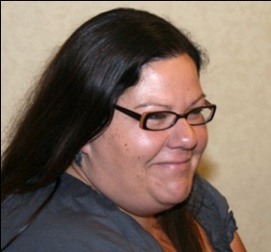
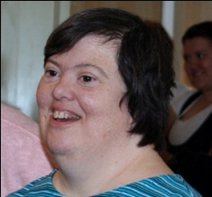
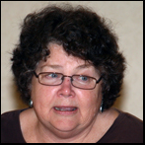
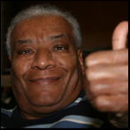
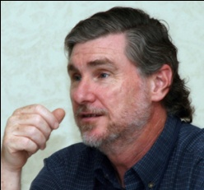
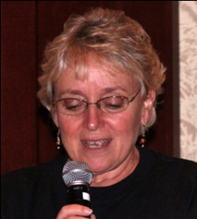
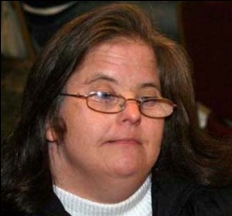
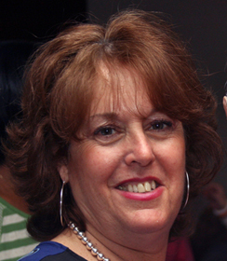
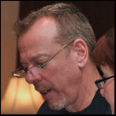
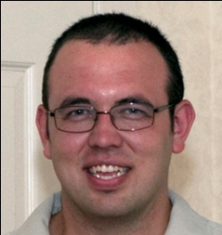
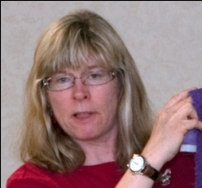
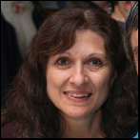
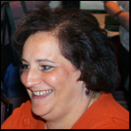
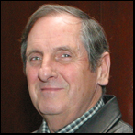
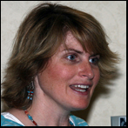
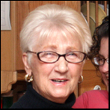
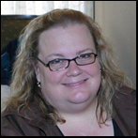
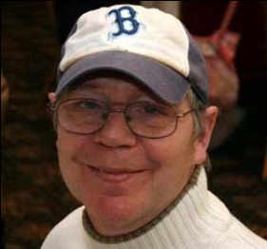
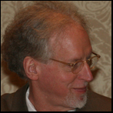
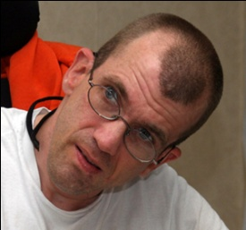
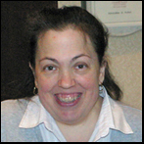
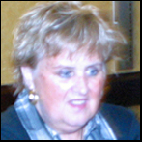
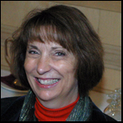

Other Resource?
People Power
PLUS!
Notes:
OTHER RESOURCES?
People Power PLUS!
In addition to financial and in-kind support, we have a tremendous pool of volunteers! This group includes both direct care staff and administrators from provider agencies, friends and family members, previous AinA board members, graduates of our Leadership Series, PAL board members and staff, Staff from the RI Department of BHDDH and people we have met along the way! We could NEVER DO what we do without this dedicated group!
Provider agencies have also helped the RI Self-Advocacy movement grow in many ways.
Agencies have purchased ads in conference programs over the years and also paid the registration fees for many Self-Advocates to attend SA events.
Several agencies have also provided support to local groups by paying a staff person to serve as advisor.
Several Advisors are volunteers.
Advisors from the local groups also help support the AinA board.

Slide 8
What Works in RI?
Being small
is a
BIG
Deal!
Notes:
Rhode Island is the smallest state in the Union. For Self-Advocacy, that is a BIG deal because Self-Advocates are connected!
All 10 of the local Self-Advocacy groups in the state meet at least once a month.
One group meets EVERY WEEK!
The AinA Board of directors meets once a month and also has officer and staff meetings in between.
We host a Leadership Series with class members from around the state which meets twice a month.

Slide 9
What Works in RI?
Collaboration
and
Teamwork
Notes:
Self-Advocacy is run by the Self-Advocates, but allies are also welcome.
We can and have worked together with support staff, family members, and others. Everyone can ride together, but everyone also needs to remember that the Self-Advocates are the ones in the driver’s seat!

Slide 10
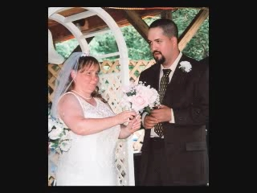
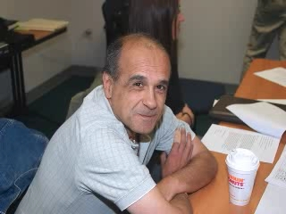
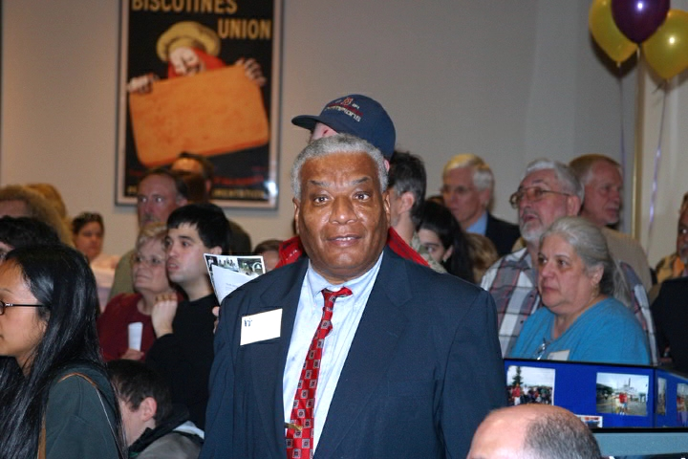
What Works in RI?
Personal Stories
of
Success!
Notes:
We have helped Self-Advocates create many personal stories of success.
Stories are powerful!

Slide 11
What Works in RI?
Being Creative
Notes:
We haven’t learned the meaning of the word “impossible”.
If it looks like we can’t do something, we stop and get creative.

Slide 12
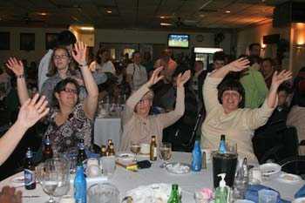
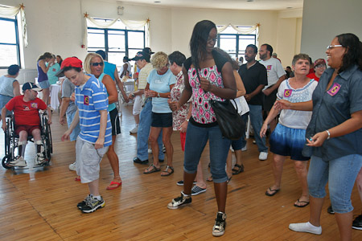
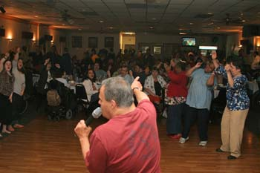
What Works in RI?
The FUN Stuff!
Notes:
We host several fun events each year and also try to include humor in our trainings and meetings.
People remember things more when they enjoy themselves, so we try to help them do that as much as possible.
Our number of attendees at these events has grown over the years.
These have always been great opportunities for people to meet other Self-Advocates and to network.

Slide 13
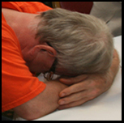
Challenges? Obstacles?
What Makes it Hard?
Support for Self-Advocates
Notes:
Self-Advocates have reported that they need support for things like:
Rides to Meetings (even if a meeting isn’t scheduled 2 weeks in advance)
Internet Access (and help learning how to use it)
Information that’s Accessible. Make it easy to understand, but not condescending.

Slide 14
Challenges? Obstacles?
What Makes it Hard?
Not Enough
Support for Self-Advocacy Groups
Notes:
Support for groups includes:
Clerical help
Places to meet
Money to hire an advisor
Support to attend Self-Advocacy events

Slide 15
Challenges? Obstacles?
What Makes it Hard?
“SELF”
Advocacy Meetings
Self-Advocates in Charge
Support Staff (Not Always) Invited
Notes:
Many Self-Advocates find it hard to discuss things freely when support staff are present.

Slide 16
Challenges? Obstacles?
What Makes it Hard?
Still having to explain who and what we are …
almost 20 years later

Slide 17
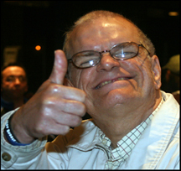
We’re Proud of …
Annual Statewide
Self-Advocacy
Conferences
and
Self-Advocacy
Meetings
Notes:
Our numbers have grown over the years at both of the annual events.

Slide 18
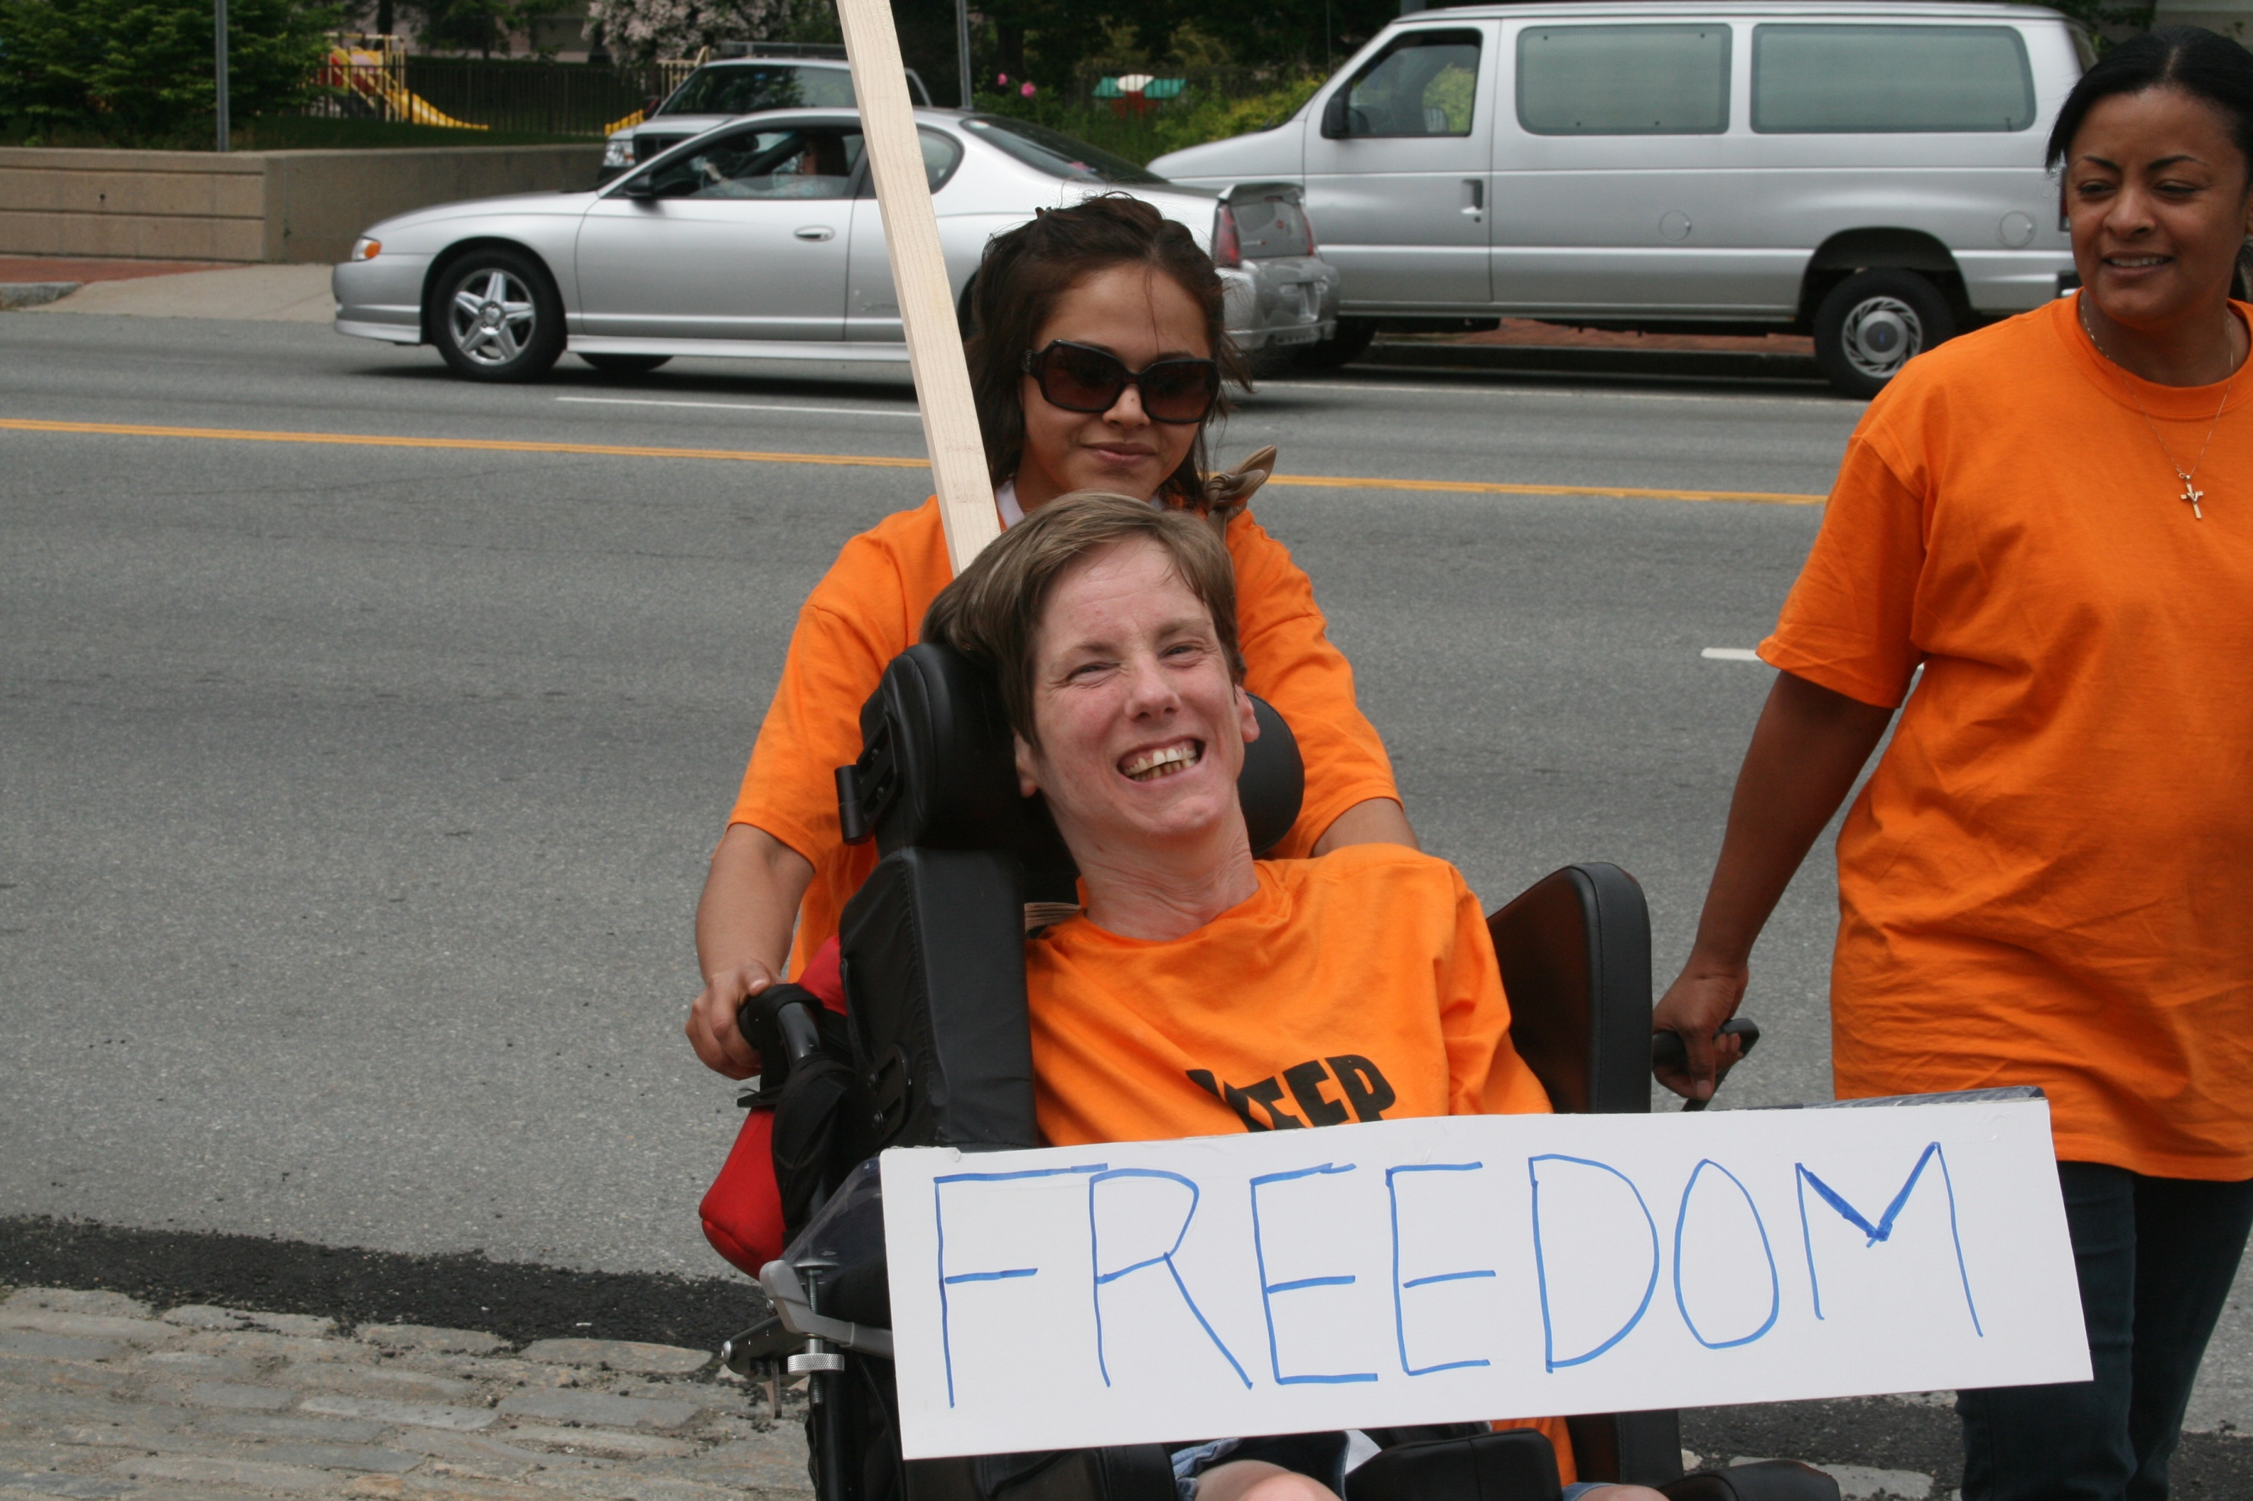
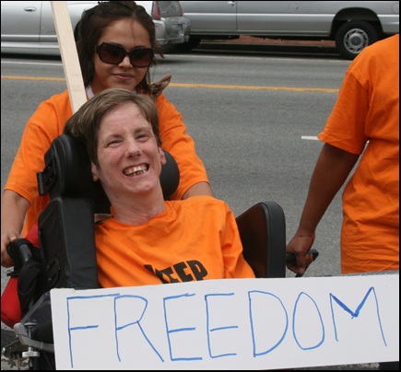
We’re Proud of …
Being Advocates
Notes:
Self-Advocates in RI know how to SPEAK UP … and we’re teaching others how to do it, too!

Slide 19
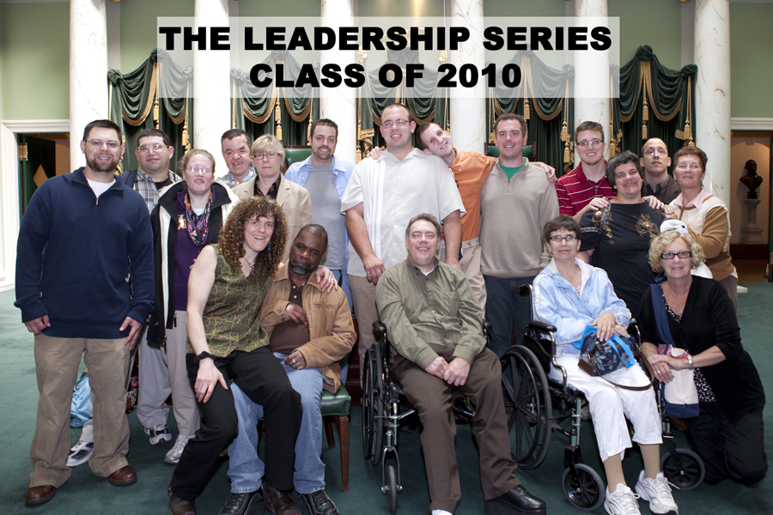
We’re Proud of …
The Leadership Series
Notes:
The Leadership Series began as Partners in Policymaking-RI, which was funded by the RI DD Council and the RI Division of Developmental Disabilites from 1996-2001
When funding for Partners ended, Advocates in Action figured out how to continue the training. (We told you we’re creative!)
We have adapted the training over the years and offered the Leadership Series to approximately 14 Rhode Island each year since 2001.
The Leadership Series is a year long training that teaches Self-Advocates how to speak up and make a difference.

Slide 20
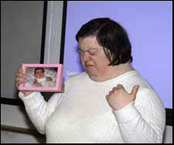
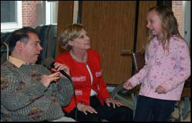
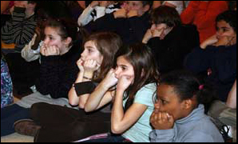
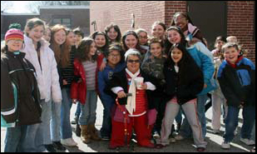
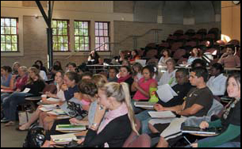
We’re Proud of …
This Is Us
Disability Awareness Training
Notes:
This is Us an interactive disability awareness training that Advocates in Action developed to teach school children, college students and others that “we are more alike than different”
We began in 2001 and have provided the training to thousands of students.

Slide 21
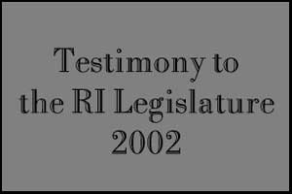
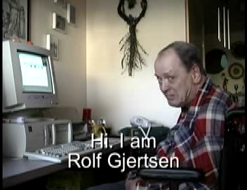
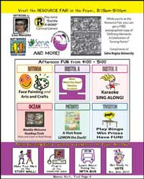
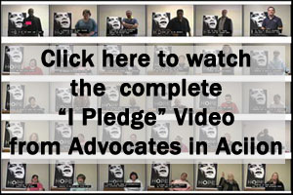
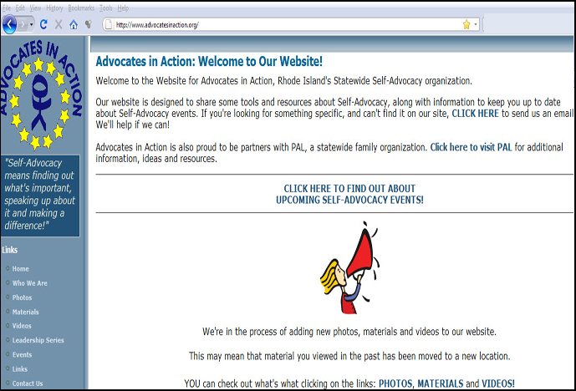
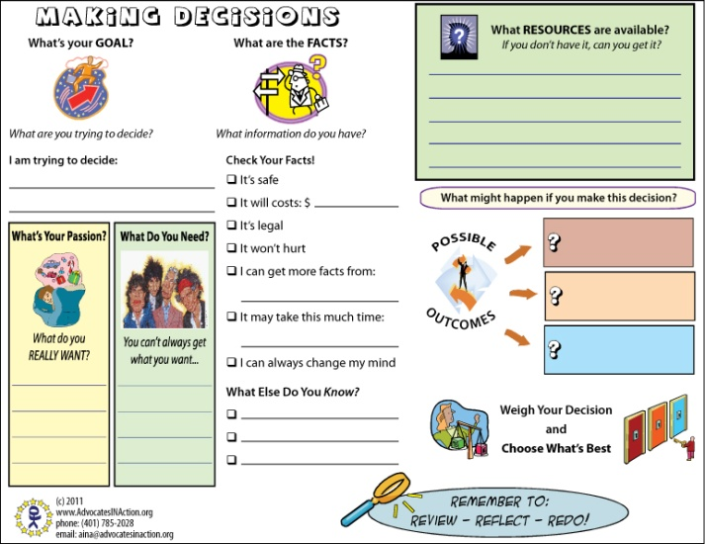
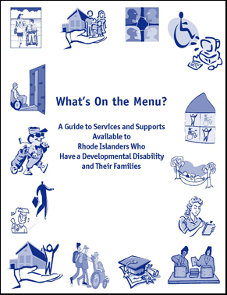

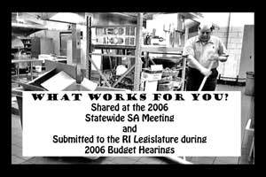

We’re Proud of …
Making and Sharing
Accessible Materials
Notes:
We create materials that are accessible in a variety of formats including print, video, multimedia and more.
We also share these materials for free on our website.

Slide 22
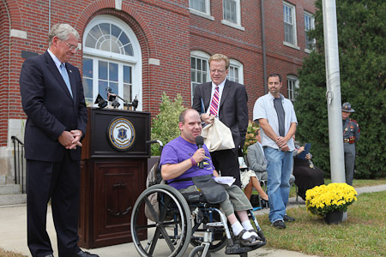



We’re Proud of …
Working to End the “R-Word”
Notes:
Our 2009 Statewide and Conference focused on the theme “Names Hurt, Too”
In 2010 the former RI Department of Mental Health, Retardation and Hospitals officially changed it’s name to the Department of Behavioral Health, Developmental Disabilities and Hospitals.
We received a citation from the RI’s former Governor Donald Carcieri for our work in this area.

Slide 23

We’re Proud of …
Notes:
We have been working with Oscar nominated Independent Film Producer Jim Wolpaw on a documentary about our state’s institution.
Ladd School closed in 1994. We’ve been interviewing former Ladd residents to capture their story.
Stay Tuned!

Slide 24


We’re Proud of …
Community…
RI Self-Advocates
Belonging and Giving Back
Notes:
Members of RI SA groups attended the national Alliance for Full Participation summit in 2005 and helped create the RI Alliance for FULL Participation in our own state.
Local group members and the Advocates in Action board collect money and donated goods for a variety of community causes on a regular basis.
Giving back is part of our mission!

Slide 25
Dreams for the Future?
Stable Funding to do OUR work
Conference Funding
Money to Hire Our Own Advisors
Introducing Young Adults to Self-Advocacy
Helping Leadership Series Graduates find
positions as Leaders in RI
Continuing to GROW!
Notes:
As Rhode Island’s Statewide Self-Advocacy organization, Advocates in Action dreams about these things…
1) Stable Funding for OUR work. BHDDH has NEVER put conditions on the money they give us. They don’t tell us how to do Self-Advocacy. That’s great – more funding without strings would be great, too!
2) A FULLY FUNDED conference – so everyone can afford to attend!
3) The ability to hire Advisors who work for us”, vs. support staff being paid by agencies to be advisors.
4) Getting Leadership Series Graduates more connected and involved as LEADERS in Rhode Island.
5) Introducing Young Adults to Self-Advocacy!
6) Continuing to help the SA movement grow in RI and beyond.

Slide 26













TEAM RHODE ISLAND!
Sarah
Kevin
Doreen
Ray
Emily
Dianne
Mary
Deb
Craig
Deanne
Tony
Keith
Mary
Notes:
TOP ROW:
Sarah Lamirande –
* Advocate in Action Board President
* We Are Homestead, SA Group President
Kevin McHale -
* Advocates in Action, Coordinator
Doreen McConaghy –
* PAL, Executive Director
Raymond Bandusky
* RI Disability Law Center, Executive Director
2ND ROW:
Emily Titon –
* Advocates in Action, Board Member
* Future RI Chapter of the Autistic Self-Advocacy Network, RI Contact
* Our Voices Count, SA Group Past President
Dianne Ross –
* Advocates in Action, Assistant Coordinator
* We Are Homestead & Northern RI Self-Advocates, Advisor
Mary Person –
* Advocates in Action, Board Member
* Citizens with Power, SA Group President
Deb Kney –
* Advocates in Action, Advisor
THIRD ROW:
Craig Stenning –
* Executive Director, RI Department of Behavioral Health, Developmental Disabilities & Hospitals (BHDDH) (HURRAY for the NEW NAME!)
Deanne Gagne –
* Advocates in Action, Coordinator
Anthony Antosh –
* Paul V. Sherlock Center on Disabilities Professor of Special Education, Director
Keith Wilcox –
* Advocates in Action, Board of Directors
* Advocates Connecting, SA Group President
Mary Okero
* RI Developmental Disabilities Council, Executive Director

