Slide 1
Reach for the Stars!
Rhode Island's 2022 Statewide
Self-Advocacy Conference
Notes:
Reach for the Stars!
Rhode Island's 2022 Statewide Self-Advocacy Conference.
Self-Directed Services: Choose Your Own Path!
You can watch a recording of this presentation on our website at:
www.advocatesinaction.org/2022breakout2-3.php

Slide 2
What Are Self-Directed Supports?
It’s my life.
I decide!
Notes:
What are Self-Directed Supports?
It’s my life. I decide!
Self-Directed Supports (SDS) give you a way to have more choice and control over the services and supports you need to live a full life at home and in the community.
With Self-Directed Supports, you, along with your family or people you know and trust, decide how to spend your Medicaid Long-term care dollars in ways that work best for you.

Slide 3
Self-Directed
vs.
Agency-Based
What’s the Difference?
Notes:
Self-Directed versus Agency-Based: What’s the Difference?

Slide 4
Agency-Based
Agency
Individual
Direct Support Staff
Services
Notes:
Agency Based
1. The individual chooses a provider agency.
2. Agency hires and trains employees.
3. Agency provides services based on the person's needs and funding levels.
4. Person has many choices and opportunities, but services cannot always be individualized.
Notice how, in the picture, the only decision the individual makes is about which agency to use. The agency in charge of the decisions. They will ask the individual what they want, but then they offer options based on their own hours of operation and what they have to offer.
Unfortunately, this usually isn’t the same thing the individual wants.

Slide 5
Self-Directed
BOSS
How to Spend Approved Plan Dollars
Fiscal Intermediary
Service Plan
Direct Support Professionals
Notes:
Self-Directed:
The individual chooses a 'fiscal intermediary' (they handle the money)
The person develops an individualized plan of support (professional plan writers are also available to assist)
The person (with assistance of family and others) becomes the employer
The person recruits, hires and trains their own employees
The person establishes pay and benefit packages
The person determines what supports are needed, when and where, and how to best spend their approved plan dollars
This picture shows that the person in charge is the individual. The individual makes all the decisions, not an agency.

Slide 6
If I’m already receiving services through an agency, can I switch to Self-Direction?
Yes! Call your Social Case Worker to get started!
Call 401-462-3421 to find out who your Social Case Worker is.
Notes:
To get started, just give your Social Case Worker a call.
If you don’t know who your Social Case Worker is, call the Division of Developmental Disabilities (DDD) at 401-462-3421 to get your Case Worker’s contact info.

Slide 7
Where Should You Start?
What Do You Need?
Notes:
Maybe self-directing sounds like a good idea to you.
So where do you start, and what do you need to get started?

Slide 8
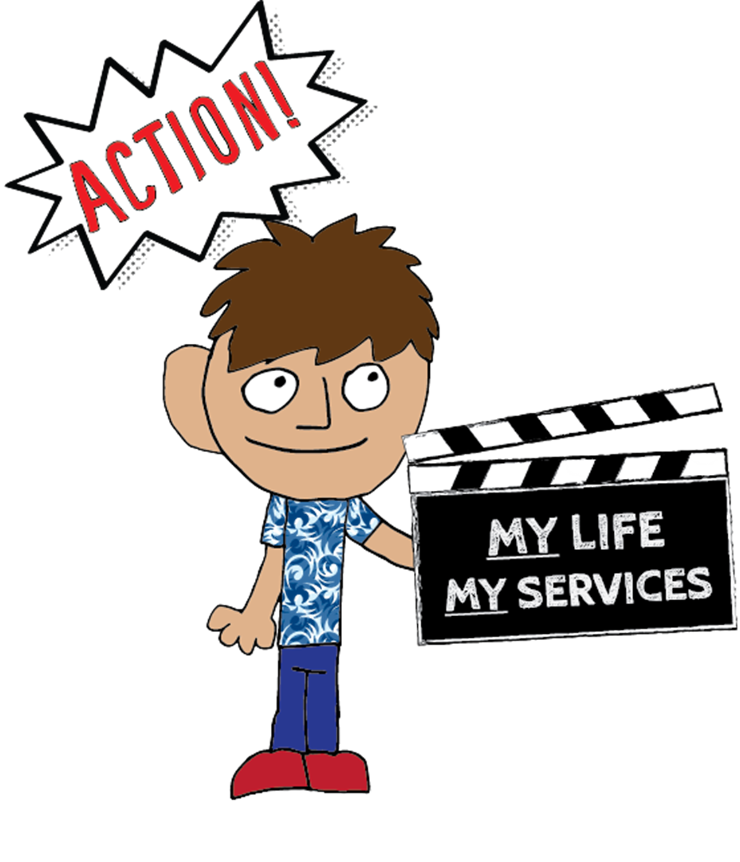
1.
2.
3.
Notes:
Here are the first steps:
Step 1. Hire a plan writer to help you create an Individualized Support Plan, or ISP. Everyone who receives DD Services in Rhode Island needs to have an ISP, whether they use an agency or they Self-Direct.
Step 2. Choose a fiscal intermediary (someone that handles the money for your supports)
Step 3. Choose, hire and train your employees

Slide 9
Creating an Individualized
Self-Directed Plan
Notes:
Make sure your ISP is Person-Centered!
Person-Centered Planning isn’t a program. It’s a way of helping a person think about their life as they answer 2 main questions: How do I want to live my life? and What do I need to do that?
A Person-Centered plan build on your strengths, experiences and dreams.
If you Self-Direct your services, you can use a portion of your funding to hire an independent plan writer to help you with this.
You also want to gather some people who know you well, and ask them to help you think about the following questions:
What are my interests, strengths, preferences, and health and safety needs?
What do I want my life at home and in the community to include?

Slide 10
What kind of supports will you include
in your Individual Service Plan (ISP)?
Notes:
Everyone who receives services through the RI Division of Developmental Disabilities needs to have an Individualized Support Plan, so you’ll need to create one as part of your first steps.
What kind of goals do you want to work on, and what supports will you include in your ISP to help you reach them?
Your ISP should set some goals that you WANT and NEED to do. It also needs to layout how you’ll go about working on this goals.
Here are some examples of things to include in your ISP:
Learning daily living skills, like cooking, cleaning, and budgeting
Community involvement
Job development
Nursing care and other professional services
Special equipment
* Watch the recording of this presentation on our website to hear Kelly and Katie share examples of things they WANT to do, and things they NEED to do.

Slide 11
Some Ideas to Consider for Your ISP
What?
How?
Goals for the Year?
What do you
WANT to do?
What do you
NEED to do?
Action Steps?
What will you put
in your ISP
to help you
reach these goals?
Notes:
Questions to think about when you develop your ISP:
What do I WANT to do? What do I NEED to do?
Which of these things will set as goals for the upcoming year?
How will I work on these goals?
What supports and skills do I already have to help me pursue these goals?
What do I need to include in my ISP to help me work on them?
What do I want my schedule for a typical week to look like?
Think about the natural supports and skills you already have. Natural supports mean people and things you already have, or you can get, that you don’t need to pay.
For example:
What can I do myself?
How can friends and family help?
What are my opportunities in the community – library, community college, faith communities, clubs, civic associations, etc.?
Once you identify your natural supports, think about what’s missing in your formula for success. This is where your PAID supports come into the picture. Your natural supports may not be enough to help you reach your goals, so what types of paid supports do you want to add? Do you need support staff to help with certain goals? Will something like a gym membership help? Do you need specialized equipment that isn’t covered by other insurance?
These are the things to include in your ISP. Remember, it’s called an Individualized Support Plan, and the thing you’re “planning” is how to live life the way you choose!
Watch the recording of this presentation on our website to hear a conversation about these questions, and other ideas to consider as you develop your ISP.

Slide 12
Hire a
Fiscal Intermediary
Notes:
Everyone who receives DD Services has an annual funding allocation, which is the amount of money they can use to purchase allowable goods and services to help them meet the goals in their ISP. But Medicaid rules don’t allow the individuals who receive services to get that money directly. Instead, they need to use something called a “Fiscal Intermediary” or FI.
An FI is an organization that they state gives a license to so they can help people who Self-Direct manage their DD Funding. FIs aren’t service providers. Instead, they write checks for you, at YOUR request, to pay for the things that are in your plan.
For example, when you hire a staff person, the FI will help you file the necessary employer paperwork. And once your staff starts working for you, they will need to keep track of their hours on a timesheets every 2 weeks. You approve that timesheet at the end of the 2 weeks, and send it to your FI.
Your FI who will submit an invoice to the Division of Developmental Disabilities for the staff hours you purchased, and use your DD funding to pay your staff for you.
On the next slide, we’ll show you a current list of approved Fiscal Intermediaries.

Slide 13
Approved Fiscal Intermediaries:
My Choice, Seven Hills 68 Cumberland Street
Woonsocket, RI 02895
Contact: Patricia Lindquist
Cell: 401-309-8008 Email: plindquist@sevenhills.org
ProPartnerships, ProAbility 25 Thurber Blvd., Unit 2
Smithfield, RI 02917
Contact: Ashley Boursiquot
Phone: 401-233-1634, ext. 6012 Email: aboursiquot@arcnbc.org
Self Directed Services, Perspectives Corporation 1130 Ten Rod Road, B101
North Kingstown, RI 02852
Contact: Nancy Lewis-Oliver, Senior Director Phone: 401-294-3990 ext. 237 Email: nlewis-oliver@perspectivescorporation.com
OPTIONS, Fogarty Center 310 Maple Avenue, Suite 102
Barrington, RI, 02806
Contact: David Reiss, Executive Director
Phone: 401-245-7900 Email: dreiss@fogartycenter.org
Works For Me, Trudeau Center 3445 Post Road
Warwick, RI 02886
Contact: Cathy D'Andrea
Phone: 401-739-2700, x203 Email: cdandrea@trudeaucenter.org
You can download this list at:
www.bhddh.ri.gov/developmental-disabilities/
services-adults/licensed-provider-lists
Notes:
This slide has a list of all of the approved Fiscal Intermediaries in Rhode Island.
You can download this list from the BHDDH website at:
www.bhddh.ri.gov/developmental-disabilities/services-adults/licensed-provider-lists

Slide 14
How Do You Find a
Direct Support Professional?
Notes:
How do you find a direct support professional?
Here are some ideas:
Church: try putting an advertisement in your church bulletin.
Ask a friend who self-directs where they found a direct support professional.
Think of someone you know who needs a job.
Think about friends of your family.
Go on your computer and advertise for a DSP on Indeed, Care.com, or Social Media.
* Watch the recording of this presentation on our website to hear Kelly share her story about how she found Karen and decided to hire her as a Support Person, or “Direct Support Professional” (DSP).

Slide 15
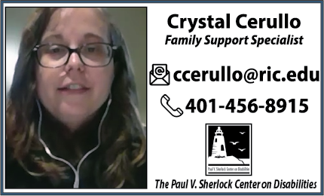
Where Can I Find More Info?
Sheila Coyne: sheilacoyne95@gmail.com
Claudia Lowe: claudia@risdc.org
Notes:
If you have questions, there are some really good people out there who have answers!
Sheila Coyne and Claudia Lowe are the founders of RI Self-Direct Coalition.
You can contact Sheila and Claudia at:
Sheila Coyne: sheilacoyne95@gmail.com
Claudia Lowe: claudia@risdc.org
Crystal Cerullo is a Family Support Specialist at the Sherlock Center.
You can contact Crystal at:
Email: ccerullo@ric.edu
Phone: 401-456-8915
All three of these people are ready and willing to help you in any way they can. Don’t be afraid to reach out to them!
You can also find resources on line at the following links:
The Division of Developmental Disability’s Self-Direct Page: www.bhddh.ri.gov/developmental-disabilities/services-adults/self-directed-services
The Sherlock Center’s Self-Direct Page: www.sdsri.net

Slide 16
© 2022
www.AdvocatesinAction.org
Notes:
Created by Advocates in Action, Copyright 2022

